Slide 1
Lab 1
Getting Started with VDMTools

Slide 2
Install VDM++ tool
Go to eLEAP.
Download the VDM++ Tool Lite, and install it in your computer.
You also can get the VDM++ tool from website: Overture Tool Formal Modelling in VDM
http://overturetool.org/
In this course we use The VDM++ Toolbox Lite Ver8.0

Slide 3
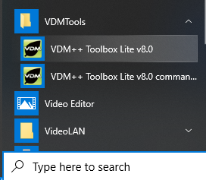
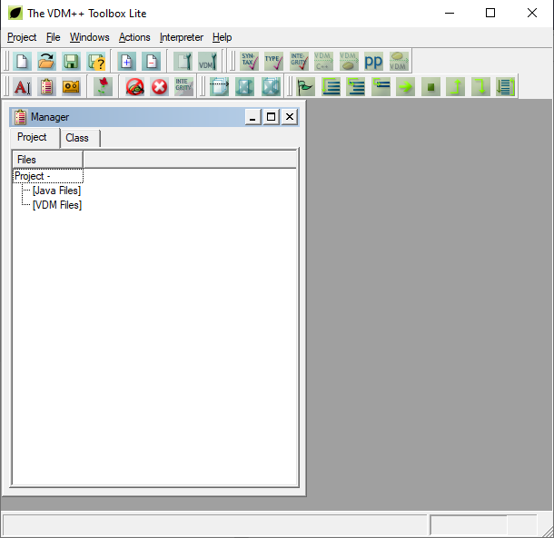

Run VDM++ Toolbox Lite
From the <Start> menu, click <VDM++ Toolbox Lite v8.0> option.
Run the VDM++ Toolbox Lite, and you should see this interface.

Slide 4
We using external editor to create VDM++ model. In this course I suggest we use Notepad editor.
Open your Notepad editor and create file using Notepad. For example.
Save as fileName.vpp
Please make sure that you remove the extension *.txt and replace it with extension *.vpp.
class Student
end student

Slide 5
Using VDMTool
Run/go To VDM++ Toolbox Lite.
Select menu ‘Project’ then select submenu ‘Add File to Project’
E.g., choose fileName.vpp (this file is created by using Notepad)

Slide 6
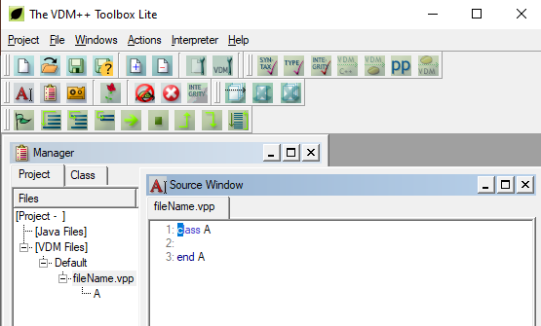
In the Manager Dialog box menu, you can ‘double click’ on the fileName.vpp file.
Then you will see the VDM++ specification (e.g. Source window)

Slide 7
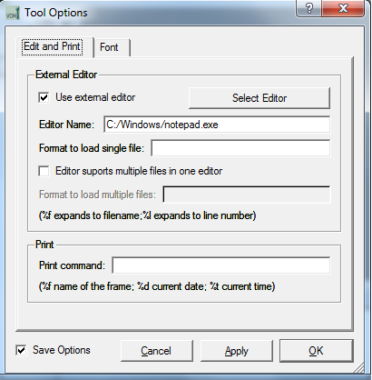
Choose Editor
To modify the specification, we can use Notepad editor.
In order to assign the Notepad editor to VDM++ Toolbox, do the following:
Select menu ‘Project’ then select ‘Tool Options’
In dialog box click button <Select Editor>.
Choose editor ‘Notepad’
Select the .exe file (i.e., notepad.exe).
This should be appear in Editor Name field C:/Windows/notepad.exe

Slide 8
Now we can open and modify the VDM++ specification by using Notepad editor.
In the Manager dialog box menu, you can ‘select/click’ the specification filename (e.g., fileName.vpp).
Under ‘File” menu select submenu ‘External Editor’, the VDM++ Specification for fileName.vpp should appear in Notepad editor.

Slide 9
Let Play !
Use class ‘Student’ as example
Manipulate the VDM++ class structure.
Define class
Define type
Define instance variable
Define operation
…
compile
save

